Slide 1

Bus Transit Prediction
Team BusNet
Brittany Giordano Senior, DSA
Daniel Redder Senior, DSA
Turner Nalley Senior, DSA

Slide 2
Summary
Timeline
Technology Updates
Exploration & Analysis Results
Roles
Git

Slide 3
Timeline
Ahead of Schedule
Currently Week 7
Deliverable
Week 1 Jan 25th-29th
Team Charter
Week 2 Feb 8th-12th
Data Gathering
Repo Creation
Deliverable II
Week 3 Feb 22nd-26th
Clean Data
Week 4 – Week 5 March 1st-12th
Data Exploration
Week 6 – Week 7 March 22nd-April 2nd
Hypothesis Establishment
Statistical Analysis
Deliverable III
Week 8 April 5th-9th
Neural Network development
Creation of Data Pipeline
Week 9 – Week 10 April 12th-23rd
Visualization & Webserver Development
Testing
Complete
Behind Schedule
Yet to Start

Slide 4










Technologies
Notebook Tools
Webserver
Source Code Management
Analysis Tools
Data Collection / Storage

Slide 5
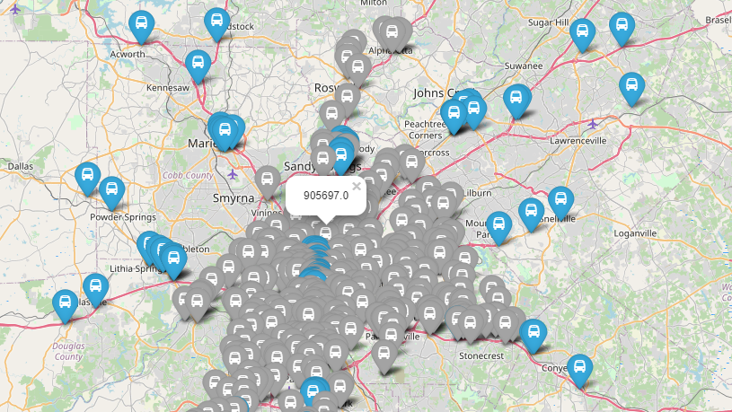
Interactive Geomap
Notes:
Brittany: Talk here about how "finding a mapping package for python was very difficult so you ended up running a r package in python which let you plot the different datasets together with popups that show information"

Slide 6
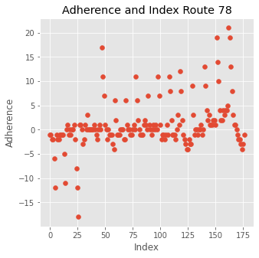
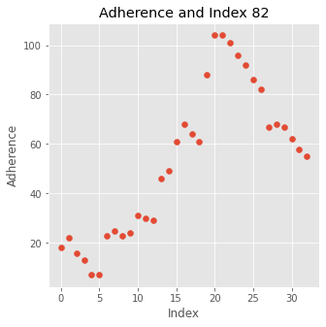
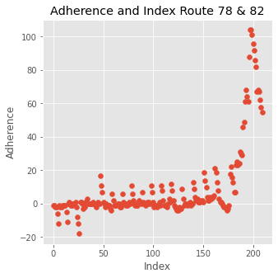
Hypothesis 1: Investigating the Statistical Performance of Vehicles Based on Route and Adherence
Vehicle 1839's worst route
Vehicle 1839's best route
Vehicle 1839's combined routes
Notes:
Turner: Don't mention the lack of regression here. Just talk about how "after looking at how each vehicle performed on average across their routes, vehicle 1839 performed the best despite going on routes that have a generally lower average adherence like route 78" Also mention that vehicle does not equal driver, so it is very interesting that a specific vehicle performs statistically significantly better then others.

Slide 7
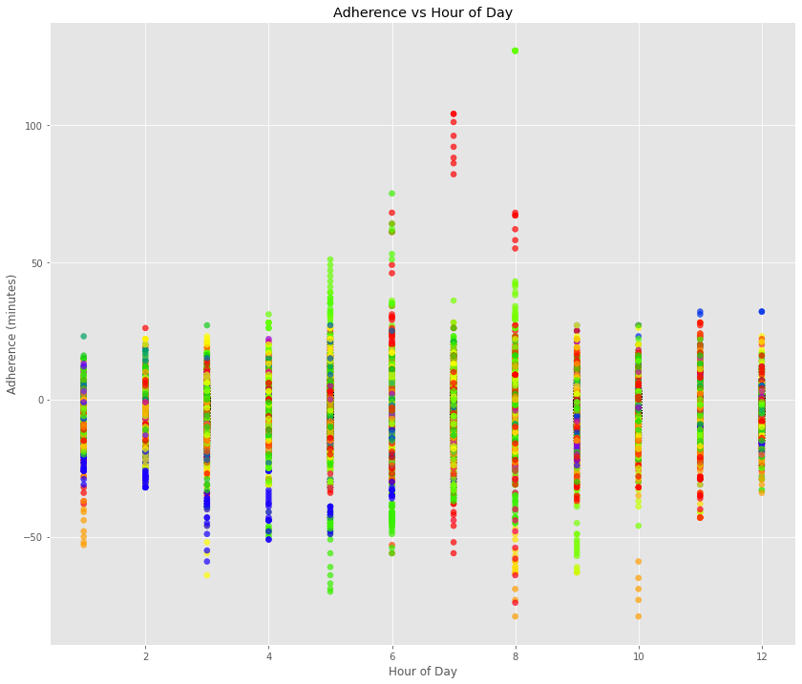
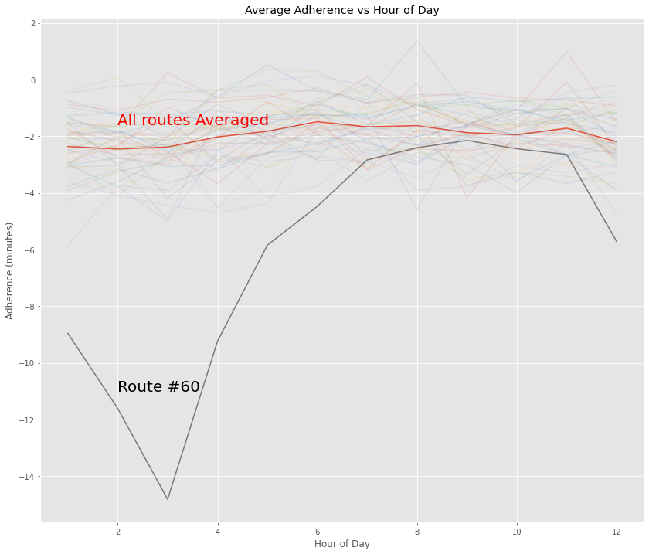
Hypothesis II Does the adherence of the bus have a relationship to time or route.
Notes:
Talk about how you "broke the data into hours to see if there are any clear trends since there was no significant ones
you broke it into hours split by routes to see if there is any hourly trend by route.
Then I found Route #60 which seems to be very dependent on hour of day.

Slide 8
Roles & Duties for Remaining Tasks
Deliverable II
Deliverable III
Statistical Analysis
Week 8 April 5th-9th
Week 9 – Week 10 April 12th-23rd
Turner
Build regression models for vehicle 1839 (the best vehicle in terms of adherence)
Daniel
Perform statistical analysis on Route #60 to determine why it is an outlier
Brittany
Add detailed information to the popups on the geomap
Creation of Data Pipeline
Neural Network development
Visualization & Webserver Development
Testing
Brittany
Create data pipeline sending data from the DynamoDB to the EC2 instance running the Neural Network.
Send data from the Neural Network alogorithim to the Flask Server
Turner
Train the data to predict location, we will need a function to take the route and times between route.
Run forward and backward propagation on said function with python code
Calculate rediction and compare it to data for accuracy.
Daniel
Write HTML/CSS to Design the Visualization Webpages
Write Flask Code to host pages
Set Up AWS DNS and EC2 Hosting
All
Run Test Predictions Directly Through the Neural Net
Perform Integration testing to confirm that data is going through the pipeline to the webserver
Test that the whole system works with Blackbox testing on the web server end

